Slide 1
eMasters Capstone Project
Predicting Student Dropout Risk in Online Learning Platforms
Early-warning prediction at the 25% course checkpoint
Student Dropout Risk Prediction | Final Evaluation

Slide 2
Group1
Team Members:
Aditya Tripathi
Kiran Bhan Singh
Mohammad Shujath
Perecharla Prasad
Mentor
Sajid Ansari
Goal: Identify students at risk of withdrawal early enough to support meaningful intervention.
Github URL: https://github.com/adityamd/iiith-capstone-project
Dashboard: http://localhost:8501
Student Dropout Risk Prediction | Final Evaluation

Slide 3
The Problem: Why Early Dropout Prediction?
Student withdrawal can often be identified only after the course has progressed significantly.
An early-warning system should predict risk while there is still time to intervene.
The challenge is to use only information genuinely available at the prediction point.
We therefore predict withdrawal using data available by the 25% course checkpoint.
Course Start
25% Checkpoint
Prediction
Support /
Intervention
Course End
→
→
→
Student Dropout Risk Prediction | Final Evaluation

Slide 4
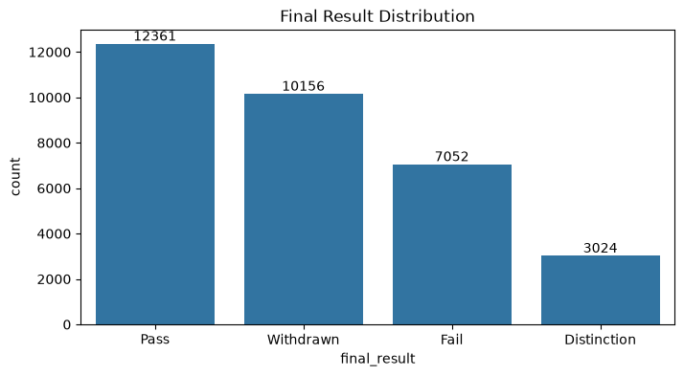
Final Result | Final Result %
Pass | 37.93
Withdrawn | 31.16
Fail | 21.64
Distinction | 9.28

Slide 5
Project Objectives
Build a reproducible student-course modeling dataset from OULAD.
Engineer leakage-safe features available at the 25% checkpoint.
Compare multiple machine learning approaches.
Address class imbalance and evaluate relevant performance trade-offs.
Assess subgroup behavior beyond overall accuracy.
Operationalize the trained models through an interactive dashboard.
Student Dropout Risk Prediction | Final Evaluation

Slide 6
Dataset and Modeling Scope
Student Data
Registration
Assessments
VLE Activity
Student-Course Dataset
→
→
→
→
OULAD relational dataset combining student profile, registration, assessment, course and VLE activity.
Final modeling dataset: 32,593 student-course enrollments.
Target: Withdrawn = 1; Pass / Fail / Distinction = 0.
54 raw leakage-safe predictors → 93 encoded/scaled model inputs.
Student Dropout Risk Prediction | Final Evaluation

Slide 7
Rank | Variable | Overall Association
1 | Highest Education | Very Strong
2 | Studied Credits (Credit Group) | Very Strong
3 | IMD Band | Strong
4 | Previous Attempts | Moderate
5 | Region | Moderate
6 | Disability | Moderate
7 | Age Band | Weak to Moderate
8 | Gender | Weak

Slide 8
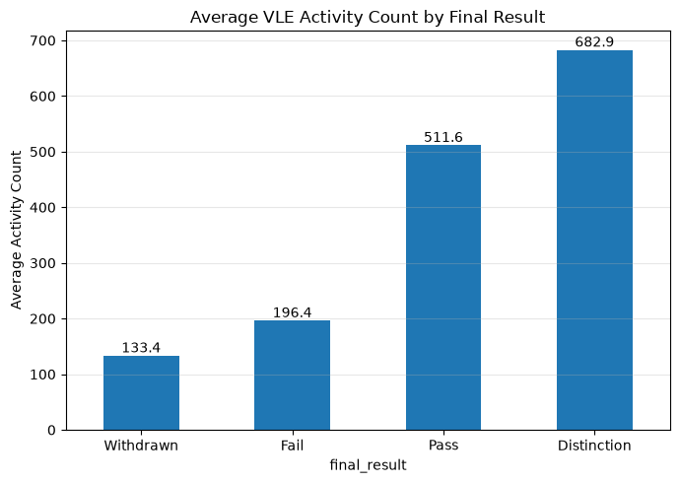
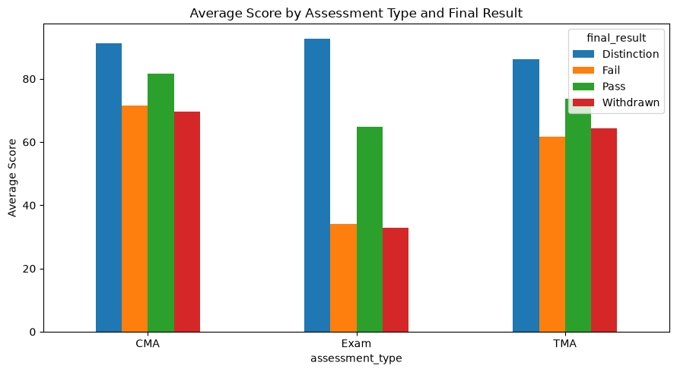

Slide 9
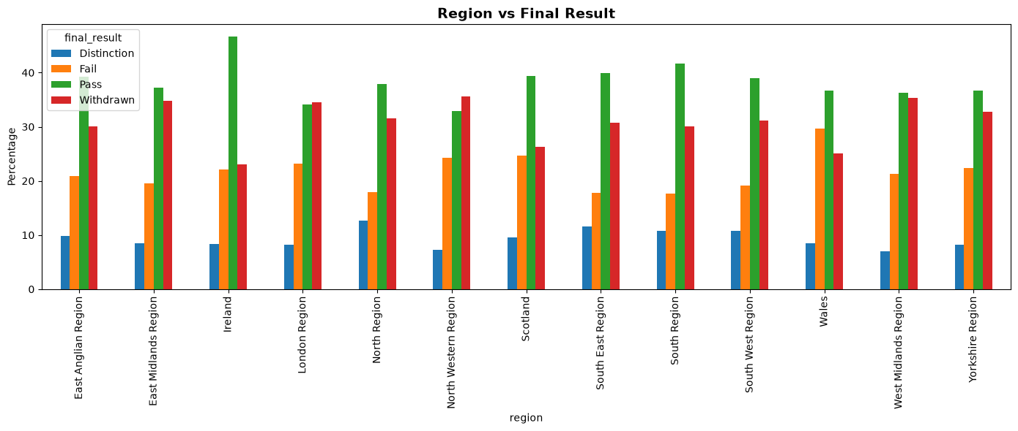

Slide 10
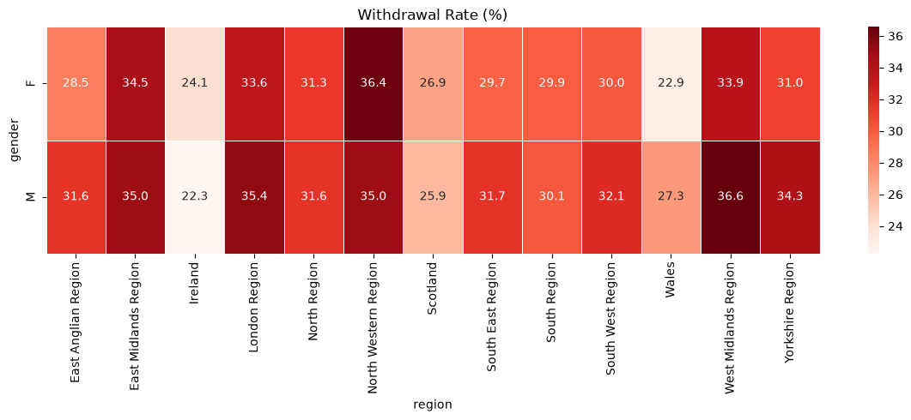

Slide 11
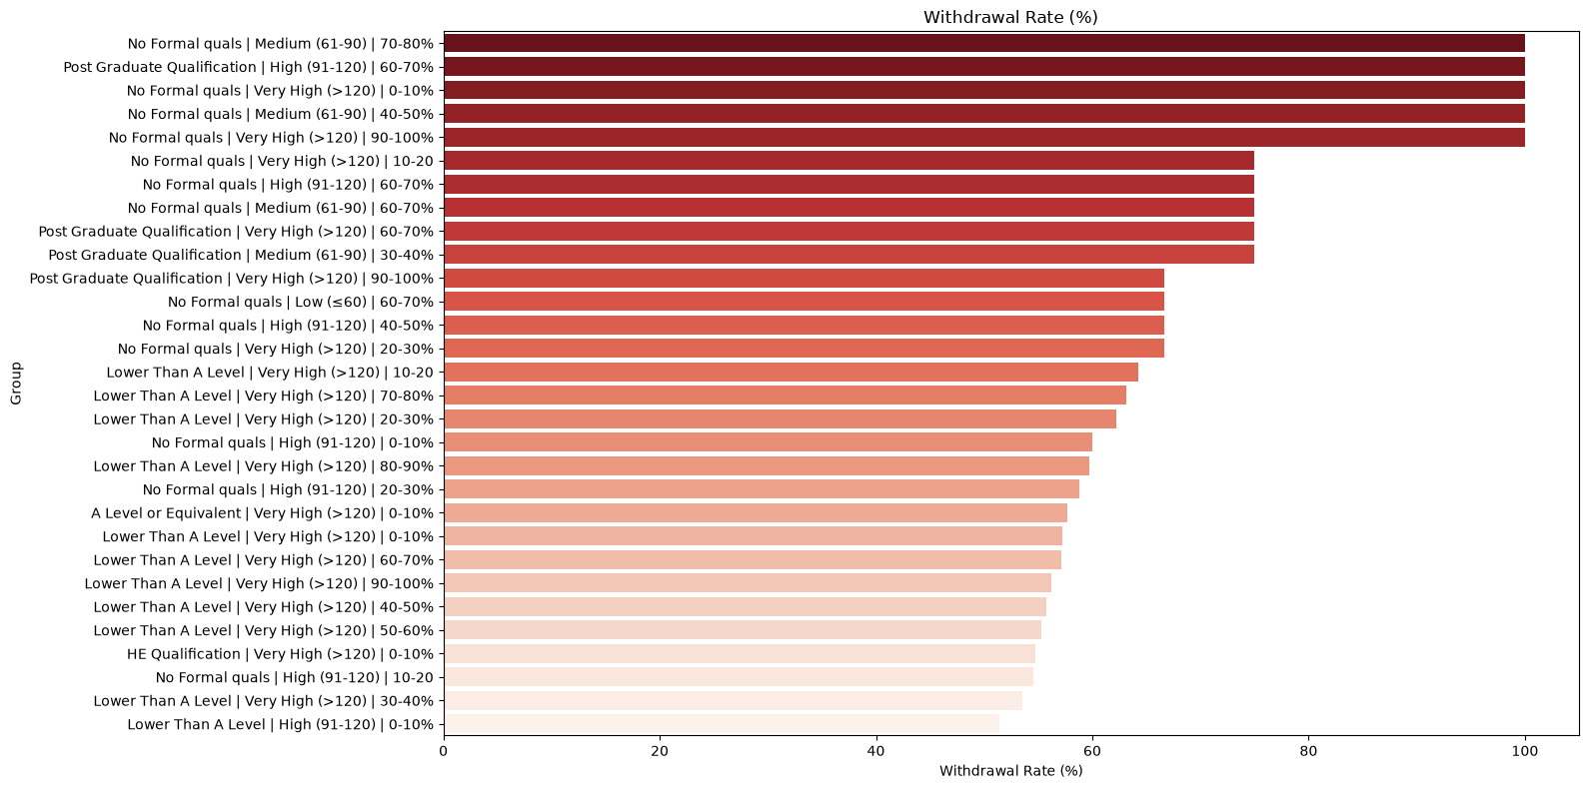

Slide 12
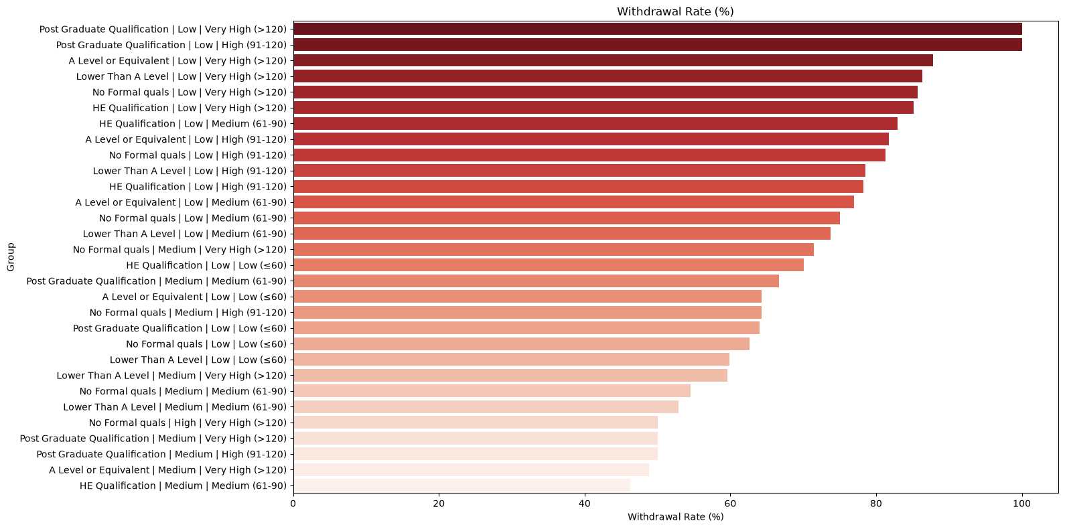

Slide 13
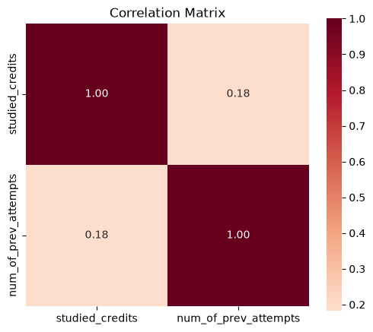

Slide 14
Key Methodological Principle: Leakage-Safe Prediction
Course Start
Only data up to
25% checkpoint
Risk Prediction
Course Outcome
→
→
→
Allowed: early VLE engagement, active days, inactivity/recency, assessments already due, early scores and registration context.
Excluded: final outcome information, date of unregistration, and activity occurring after the checkpoint.
This makes the evaluation closer to a realistic early-warning scenario.
Student Dropout Risk Prediction | Final Evaluation

Slide 15
Feature Engineering: From Raw Records to Early-Warning Signals
Raw OULAD Tables
25% Checkpoint
Filtering
Feature
Engineering
54 Safe Features
93 Model Inputs
→
→
→
→
Student Profile
Age, education, previous attempts
Registration
Registration timing
Course Context
Module, duration
VLE Engagement
Clicks, active days, recency
Assessment Behavior
Missing submissions, scores, delays
Student Dropout Risk Prediction | Final Evaluation

Slide 16
Evaluation Design: Student-Grouped Split
All Enrollments
Group by Student ID
Training
70%
Evaluation
15%
Test
15%
→
→
→
→
Every enrollment belonging to the same student is kept in one partition.
This prevents the same student's information from appearing in both training and testing.
Training: model fitting | Evaluation: model selection | Test: final held-out comparison.
Final results are reported on the common grouped test partition.
Student Dropout Risk Prediction | Final Evaluation

Slide 17
Model Development and Selection
Baseline Models
Model Comparison
Imbalance
Experiments
Weight Sensitivity
Final Model
→
→
→
→
Compared Logistic Regression, tree-based models and a tabular neural network.
Explored class imbalance strategies and weight sensitivity.
Final selected model: HistGradientBoosting (HGB).
Selected imbalance approach: sample weighting with withdrawal weight = 3.0.
Model | Accuracy | Balanced Acc. | ROC-AUC | PR-AUC | Precision | Recall | F1
Logistic Regression | 0.825 | 0.807 | 0.874 | 0.802 | 0.710 | 0.757 | 0.733
Random Forest | 0.837 | 0.788 | 0.883 | 0.819 | 0.797 | 0.652 | 0.717
HistGradientBoosting | 0.832 | 0.813 | 0.883 | 0.824 | 0.724 | 0.759 | 0.741
XGBoost | 0.833 | 0.815 | 0.885 | 0.824 | 0.724 | 0.764 | 0.744
Student Dropout Risk Prediction | Final Evaluation
Notes:
Prasad

Slide 18
Final Model Performance
Accuracy
0.816
Balanced Accuracy
0.804
ROC-AUC
0.874
PR-AUC
0.797
Withdrawal Precision
0.667
Withdrawal Recall
0.775
Withdrawal F1
0.717
Key takeaway: The selected HGB model identified approximately 77.5% of actual withdrawals on the final grouped test set.
Student Dropout Risk Prediction | Final Evaluation
Notes:
Prasad

Slide 19
What Drives Early Dropout Risk?
Missing Early
Assessments
Low VLE
Engagement
Long Inactivity /
Recency
Weak Early Academic
Performance
→
→
→
The strongest recurring predictive signals came from early assessment behavior and learning engagement.
These features indicate predictive association—not causation.
The results can support targeted attention, but they do not prove that changing one feature alone will change an outcome.
Student Dropout Risk Prediction | Final Evaluation
Notes:
Prasad

Slide 20
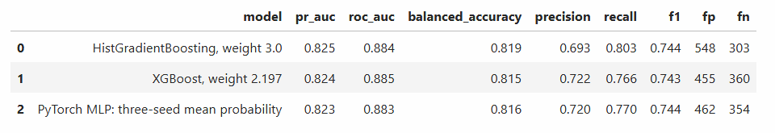
Beyond Accuracy: Model Comparison and Responsible Evaluation
Compared multiple model families instead of relying on a single algorithm.
Conducted subgroup-oriented evaluation to understand performance trade-offs.
The three-seed PyTorch MLP was competitive but did not clearly outperform the selected HGB model.
Model choice considered predictive performance together with practical trade-offs.
Student Dropout Risk Prediction | Final Evaluation
Notes:
Prasad

Slide 21
Final Metrics
Metric | Value
Accuracy | 0.816
Balanced Accuracy | 0.804
ROC-AUC | 0.874
PR-AUC | 0.797
Withdrawal Precision | 0.667
Withdrawal Recall | 0.775
Withdrawal F1 | 0.717
Student Dropout Risk Prediction | Final Evaluation
Notes:
Prasad

Slide 22
Interactive Three-Model Inference Dashboard
Selected Case
54 Raw Features
Saved Preprocessing
93 Inputs
LR / HGB / MLP
Risk + Decision
→
→
→
→
→
Compare Logistic Regression, HistGradientBoosting and the three-seed neural network side by side.
Run individual models or all models together.
Adjust the case-level decision threshold.
Perform what-if editing of selected engagement or assessment inputs.
Explore performance, prediction differences and curated example cases.
Student Dropout Risk Prediction | Final Evaluation

Slide 23
Fairness Evaluation: Key Findings
DPD compares eligible-group alert rates; EOD compares withdrawal recall (TPR). Lower gaps indicate more similar observed outcomes.
Across Logistic Regression, Histogram Boosting, and the Neural Network, gender gaps were small (DPD 0.006–0.030; EOD 0.006–0.016), while disability gaps were larger.
Largest DPD: 0.238 for disability × deprivation (Histogram Boosting). Largest EOD: 0.171 for IMD band (Logistic Regression). The earlier MLP audit also found larger gaps for IMD and highest education.
No model minimized every gap. These are descriptive test-set checks; eligible groups require at least 30 withdrawals and 30 non-withdrawals, while the 55+ estimate was uncertain because it contained only 34 observations.
Student Dropout Risk Prediction | Final Evaluation
Notes:
[Sources]
- Student_Dropout_Capstone_report_v2.docx, Section 14, Fairness Analysis.

Slide 24
Live Dashboard Demonstration
1. Select a curated student case.
2. Run all three models and compare withdrawal probabilities.
3. Demonstrate the case: “HGB catches a withdrawal others miss.”
Logistic Regression ≈ 11% | HGB ≈ 75% | Neural Network ≈ 23%
4. Change the decision threshold and observe the classification change.
5. Use what-if editing and rerun the models.
Important: the threshold slider changes the displayed case decision, not the published benchmark metrics.
Student Dropout Risk Prediction | Final Evaluation

Slide 25
Conclusion
Early dropout prediction is feasible at the 25% course checkpoint.
Strict leakage control is essential for credible early-warning modeling.
Student-grouped evaluation reduces the risk of learner overlap across partitions.
Early assessment behavior and engagement provide valuable predictive signals.
HistGradientBoosting delivered the strongest final benchmark among the selected approaches.
The dashboard translates the model artifacts into an interactive comparison and what-if experience.
Key contribution: a realistic, leakage-safe early-warning system built around information available when intervention is still possible.
Student Dropout Risk Prediction | Final Evaluation

Slide 26
Backup: Limitations and Future Work
Limitations
One fixed grouped split and a historical test partition.
A 0.50 threshold may not be operationally optimal for every intervention setting.
Assessment-score availability should be validated for real-world deployment.
Future Work
Probability calibration and capacity-based threshold selection.
Repeated grouped and temporal validation.
Sequence-based modeling of weekly engagement patterns.
Explainable advisor-facing summaries and deployment monitoring.
Student Dropout Risk Prediction | Final Evaluation

